Slide 1
U
CAMPUS E-COMMERCE PROJECT
Demo & Architecture Deck
UMG Personaliza
Custom campus products, from design to delivery.
Presentation Scope
Recommended Duration
Buyer Journey & Architecture
8 - 10 Minutes

Slide 2



01. Context
Core Need Analysis
The Problem
Student Demand
Order Friction
Staff Visibility
Students need personalized university products tailored to their specific campus identity.
The purchasing process must be simple, web-accessible, and strictly campus-oriented.
Campus staff require order preparation visibility and verifiable delivery evidence.

Slide 3

02. Product Overview
Unified Campus Platform
Our Solution
1
Product Catalog
Browse campus-ready merchandise items available for instant customization.
2
A/B-Side Personalization
Configure front and back surfaces with dynamic visual filters and custom text.
3
Campus Delivery Areas
Designate specific campus meeting spots for fast and organized collection.
4
Order History & Live Tracking
Real-time progress monitoring from checkout confirmation to handoff.

Slide 4




03. System Operations
Speaker 2 • Roles & Journey
User Roles
Buyer
Administrator
Supervisor
Delivery Driver
Customizes items, places campus orders, and follows real-time delivery status.
Manages catalog, updates operational settings, and oversees entire platform logic.
Monitors store sales metrics and reviews general fulfillment analytics.
Performs manual code search, captures signature evidence, and completes handoff.

Slide 5
04. User Flow
7-Step End-to-End Flow
Buyer Journey
1
2
3
4
5
6
7
Login
Browse
Personalize
Cart
Checkout
Track
Receive
JWT Auth
Catalog
A/B Editor
Review
Campus Area
WebSocket
Signature

Slide 6
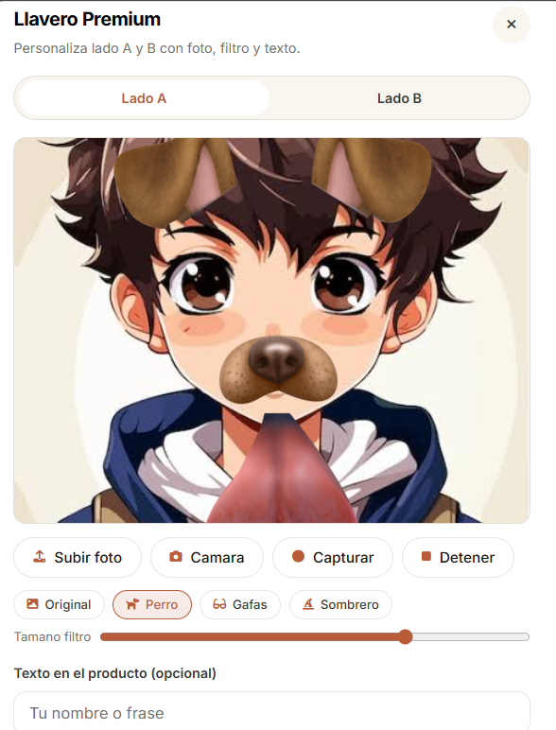
05. Feature Deep Dive
Personalization Experience
Image Input: Upload local photos or utilize live camera capture.
Visual Overlay Filters: Apply original, dog, glasses, or hat effects.
Transform Controls: Adjust filter scale and positioning dynamically.
Text Additions: Include custom text slogans or student names.
Dual Surface Support: Separate Side A and Side B configuration tabs.

Slide 7



06. Checkout Process
Speaker 3 • Order Operations
Checkout & Order Creation
Campus Delivery Location
Designated meeting area selection with optional delivery notes.
Payment Integration Note
Demo Card Payment
Cash on Delivery
In-person cash payment confirmation upon receiving order.
The card option creates a mock reference only. It is not connected to a banking gateway and references are not stored as real financial transactions.
Order Confirmation & Receipt
Unique order code generation and optional downloadable PDF receipt.

Slide 8
07. State Machine
Finite State Machine
Order Lifecycle
1. Received
2. Preparation
3. On Route
4. Meeting Point
5. Delivered
!
Exception Handling: Recipient Not Found
Retry Delivery
Cancel Order
Prevents arbitrary state jumps and guarantees clean operational records.

Slide 9
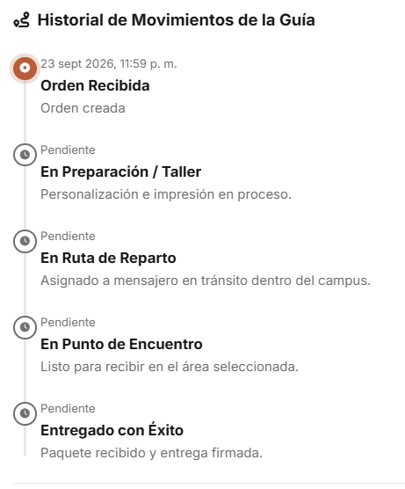
08. Fulfillment Evidence
Tracking & Delivery Evidence
WebSocket Live Updates: Real-time status push to buyer tracking screen.
Delivery Photo Capture: Driver attaches physical package proof photo.
Digital Signature Canvas: Recipient signs directly on driver screen.
Manual Code Lookup: Driver searches orders by order code (not QR scan).
Signature Storage Note: The signature canvas is currently uploaded as image evidence. A dedicated database signature field is pending.

Slide 10




09. System Design
Speaker 4 • Tech Stack & Security
Technical Architecture
Browser Frontend
REST / WebSocket
Vanilla JS, HTML5, CSS3, Signature Canvas
Express REST API
State Machine Logic
Node.js, Express Router, JWT Auth Middleware
MySQL Store
External Microservices
Relational Business Data
PDF Generator, SMTP, WhatsApp API

Slide 11
10. Compliance
Production Standards
Security & Quality Controls
JWT & HttpOnly Cookies
Bcrypt Hashing
Role authorization with secure token cookie refresh behavior.
Secure password encryption for all platform user accounts.
Input Limits & Validation
Audit Logs & reCAPTCHA
API rate limiting and payload upload file-size restrictions.
Action tracking records and anti-bot checkout validation.

Slide 12
11. Live Demo
7-Step Live Execution
Demonstration Plan
1
Login as Buyer
2
Personalize Product (A/B)
3
Add Item to Cart
Backup Plan & Tech Limitation
Authorization Mismatch
4
Confirm Checkout
The current state-change route contains an authorization mismatch ( vs ) and may reject transitions. Pre-generated backup order codes are prepared for demo continuity.
req.user
req.auth
5
Open Tracking View
6
Update Order as Staff
7
Confirm Delivery & Signature

Slide 13
12. Scope Evaluation
Implemented vs Future Scope
Current Scope & Limitations
Implemented Scope
Known Limitations
• Functional A/B side product visual editor
• Card payment is a mock reference (no live banking)
• End-to-end checkout with campus location selection
• Driver order lookup is manual code entry (no QR scan)
• Live WebSocket tracking timeline
• Stock deduction needs transactional validation
• Delivery driver signature canvas & photo capture
• Signature stored as uploaded image, not separate data

Slide 14

U
UMG Personaliza
Design it. Order it. Track it. Receive it.
Thank you for your attention. We are ready to answer your questions and demonstrate the platform live.

